Slide 1
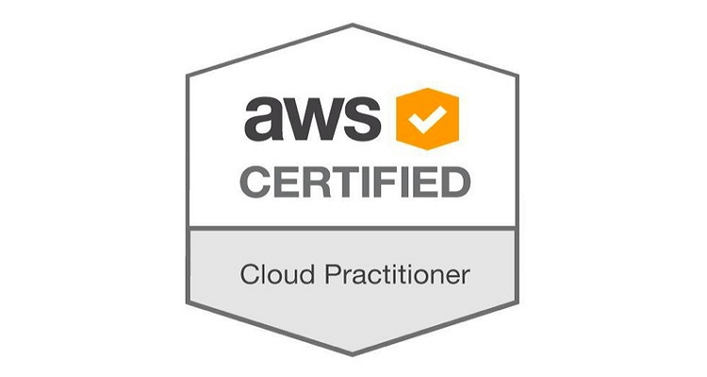
AWS Cloud practitioner SESSION
SME Connect
Berno Raj (665919)
Nemish Karthik (666301)
Enoch Jerome Singh (658711)

Slide 2
Agenda
About AWS
Hierarchy of Exams
How to register?
How to take the exam?
Overview on Syllabus
Benefits of taking Cloud Practitioner
Reimbursement
Experience sharing
Quiz

Slide 3
AWS on A Quick GLANCE
Market leader among cloud service providers
Easy to use
Flexible
Cost-Effective
Reliable
Scalable and high-performance
Secure
Pay for what you use

Slide 4
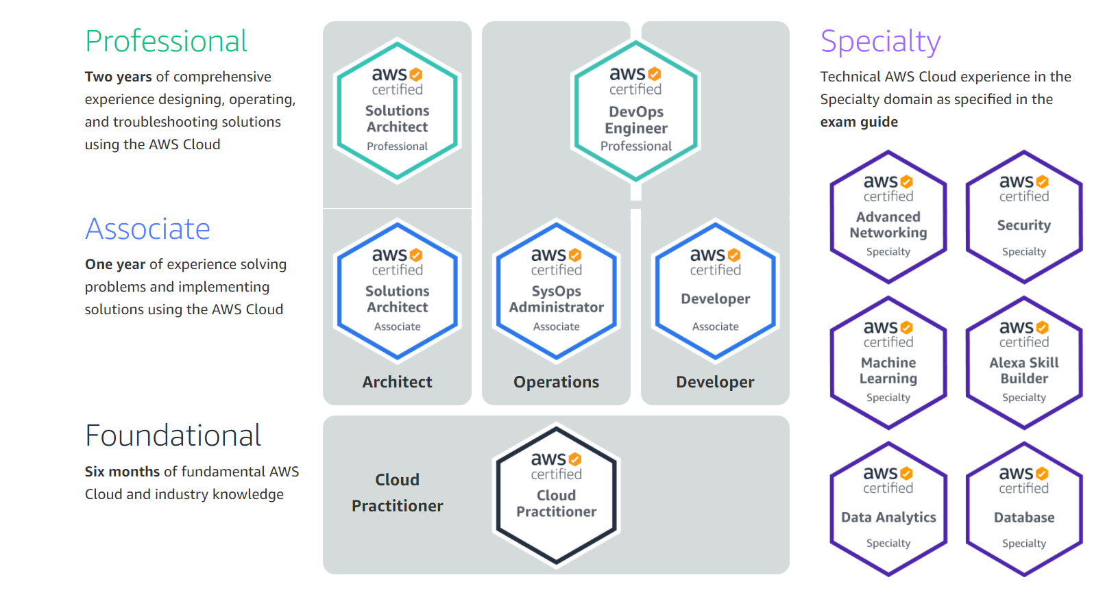
Hierarchy of Exams

Slide 5
Registration for exam
Login into : this.URL
Use “Cognizant Email ID” to register APN portal.
Please note that creating account in APN portal is different from , creating an AWS Service Account.

Slide 6
How to take exams?
2 types
By TEST CENTER – PSI (Recommend to go to)
By PROCTORED EXAM – PEARSON VUE ( can be written from your home)
Cost?
$ 100 USD (~7,352.98 Indian Rupee)
Practice Exam: $ 20 USD
Allocated time ?
90 minutes
How many Questions?
65
Passing Score?
70%
Valid for?
3 years

Slide 7
Cloud practitioner at a glance
Describe the AWS Cloud value proposition (AWS with 31% of the market, Azure at 20%, Google Cloud at 6%)
Describe the AWS Cloud and the AWS global infrastructure
Recognize and explain basic AWS Cloud architectural principles
Describe key services on the AWS platform and their common use cases
Describe the basic security and compliance aspects of the AWS platform and the shared security model
Define the billing, account management, and pricing models
Describe basic/core characteristics of deploying and operating in the AWS Cloud

Slide 8
Overview on syllabus
Cloud concepts – 28%
Defines AWS cloud and its value propositions
Identifies aspects of AWS Cloud economies
Lists different cloud architecture design principles
Security – 24%
Defines AWS shared responsibility model
Defines AWS cloud security and compliance concepts
Identify AWS access management capabilities
Identify resources for security support
Technology – 36%
Defines methods of deploying and operating in the AWS Cloud
Defines the AWS global infrastructure
Identify the core AWS services
Identify resources for technology support
Billing Pricing – 12%
Various pricing models for AWS
Recognise various account structures in relation to AWS billing and Pricing
Identifying Resources available for billing support

Slide 9
How was it?
We finished the exam in an hour!!
If you are new to cloud , then the exam will be moderate .
If you have prior knowledge on cloud it will be a cake walk for you!!.
TIPS
Answer the direct questions first, Flag the questions if you are not sure about the answers, you can take up in the end.
Eliminate all the choices that are not relevant to the question first and then choose the correct answer.
Learn what each services are used for.

Slide 10
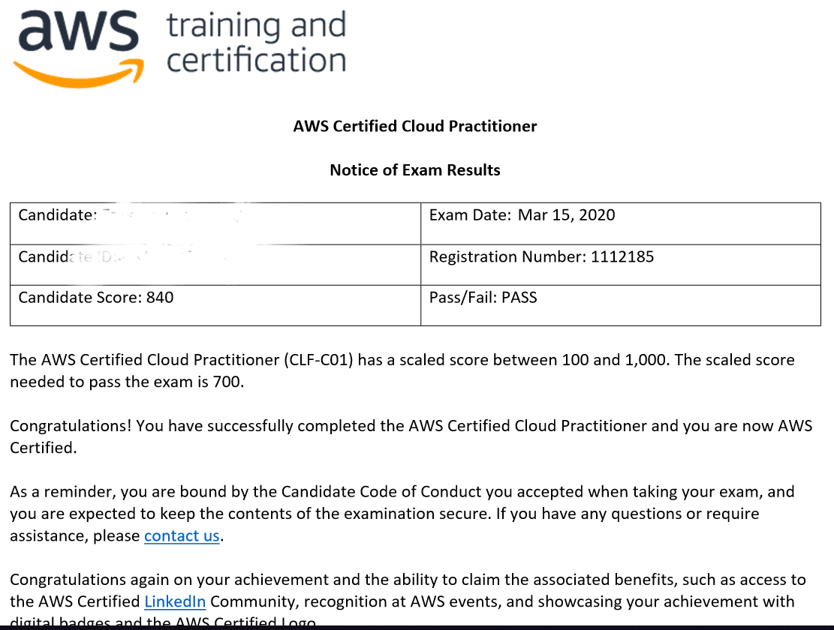
Final marksheet

Slide 11
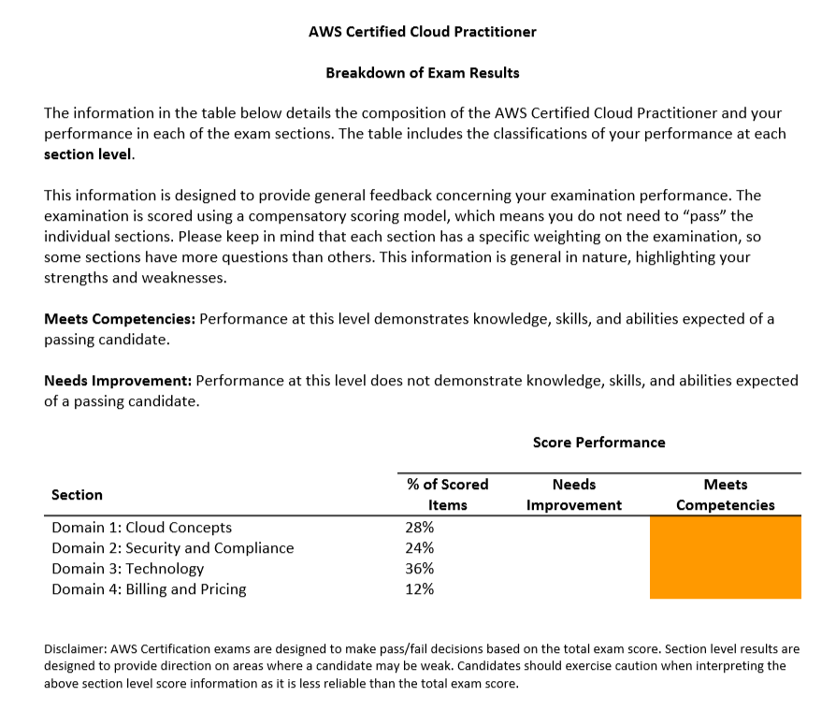
Marksheet- breakdown

Slide 12
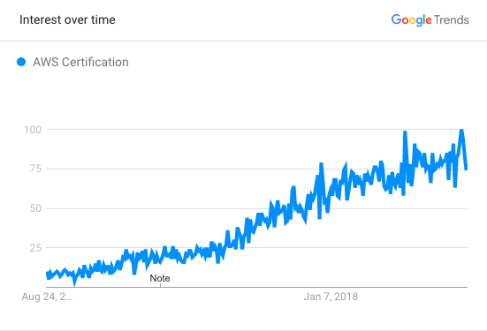
BENEFITS OF TAKING CLOUD PRACTITIONER
It focuses on Billing and business-centric concepts
Commonly obtained by sales and management to help inform VPs or CEO reasons to utilize AWS
Can help superficially increase your AWS Certification count
It boosts your confidence as foundation is more important.
Inexpensive exam
Advantages
Credibility
Help you get a job
Higher pay
Improve skills
Helps you built the business
Huge benefits
Opportunity to become a Subject Matter Expert
You can demand more CTC while switching your job
Some companies have KPIs that an employee has to do some IT certification related to the technology they work

Slide 13
Dumps
https://free-braindumps.com/amazon/free-aws-certified-cloud-practitioner-braindumps.html
https://www.examtopics.com/exams/amazon/aws-certified-cloud-practitioner/view/
https://www.prepaway.com/aws-certified-cloud-practitioner-exam.html
https://cognizant.udemy.com/course/aws-certified-cloud-practitioner-practice-test/
https://cognizant.udemy.com/course/aws-certified-cloud-practitioner-practice-exams-c/learn/quiz/4550475/results?expanded=266320972#overview

Slide 14

QUESTIONS???

Slide 15

THANK YOU ☺

